Slide 1
CSE 325 Operating Systems Project – The sandwich problem
Submitted to:
Masiath Mubassira
Lecturer
Department of Computer science and engineering

Slide 2
Group Members
Moniruzzaman Shanto
ID : 2018-1-60-075
Shimanto Krishna Chakroborty
ID : 2017-2-68-001

Slide 3
Problem Description
The Sandwich Problem is a kind of problem where senior student will provide any two item among bread, cheese and sausage. Among three juniors only one will be able to make the sandwich who has the third item. however the other two juniors can not make a sandwich because they do not have the last item.

Slide 4
Solution Methodology
Semaphore:
used to lock the critical section for other process.
Thread:
performs the operations.

Slide 5
Algorithm
threads for senior and three juniors
pthread_create(&t1, NULL, senior, NULL);
pthread_create(&t2, NULL, junior1, NULL);
pthread_create(&t3, NULL, junior2, NULL);
pthread_create(&t4, NULL, junior3, NULL);

Slide 6
Algorithm
Thread created for senior will execute “void *senior()” function
sem_wait(&m);
Take two input among bread, cheese and sausage which will be provided to juniors.
Prints both items which senior has provided.
sem_post(&m);

Slide 7
Algorithm
Junior1, Junior2 and Junior3 will start execution from function void *junior1(), void *junior2() and void *junior3() serially.
sem_wait(&m);
Each Junior will check which item senior did not provided.
If the missing item match with the item which junior dose have then that junior will get both items.
Signal = 1; (sends signal to senior)
sem_post(&m);

Slide 8
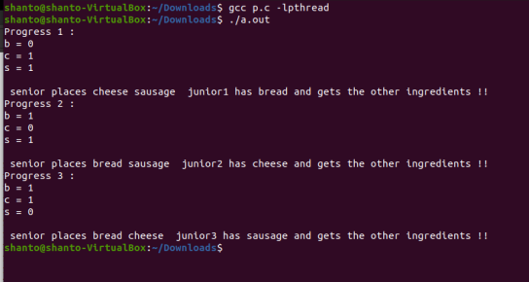
Output

Slide 9
THANK YOU

